Slide 1
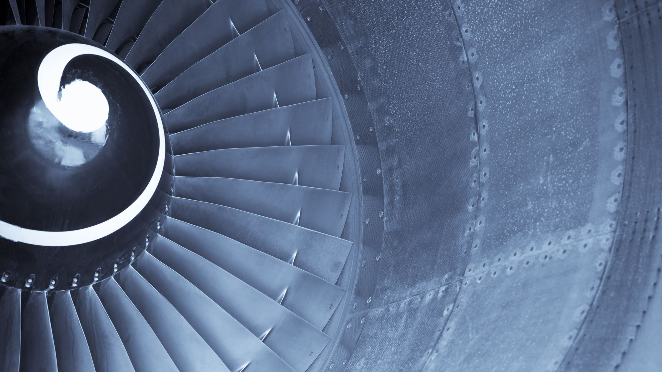
GE Aerospace
Electrical Engineering Task 1

Slide 2
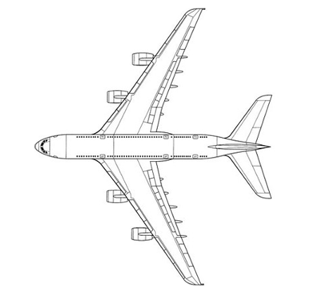
Design Your Power Distribution
To design your power distribution system in PowerPoint, consider the following guidelines on how to use shapes to represent different components:
Lines and Arrows: Use these to depict electrical connections between components. For example, a solid line could represent primary power connections, while a dashed line might indicate secondary or backup connections.
Rectangles and Squares: Ideal for representing distribution panels and circuit breakers. You can use labels or different colors to differentiate between primary and secondary panels.
Circles or Ellipses: These could symbolize generators or other power sources. Position them at the beginning of your power flow diagram to indicate where the power originates. Engine 1 generator, engine 4 generator, and the main battery are common power sources, shown on the following diagram.
Triangles or Diamonds: Use these shapes to denote electrical and avionics systems that require reliable power from the distribution panels. Common systems are shown on the following diagram.
Remember, each shape's size, color, and placement should help clarify the system's layout and operation, making it intuitive for someone else to understand your design rationale.
Use the aircraft diagram on the next slide to design your power distribution system.

Slide 3
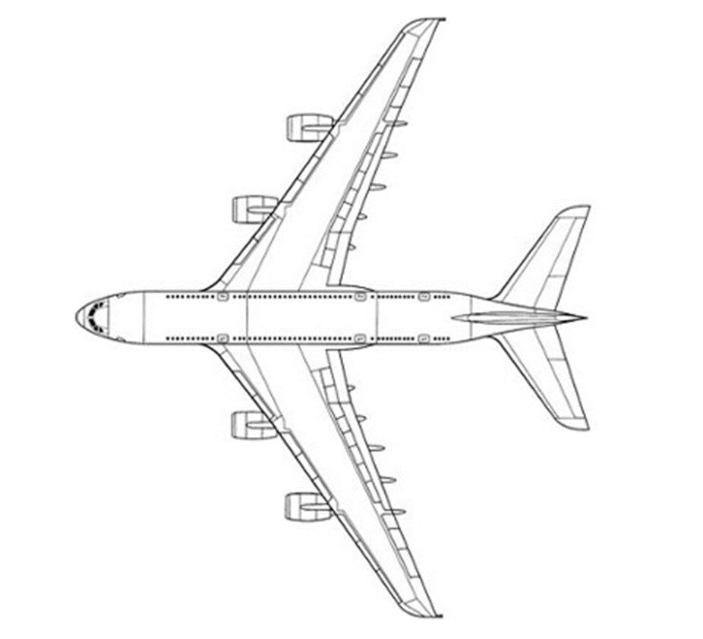
Engine 4 Generator
Navigation Memory
Bleed Air Control
Pilot Windshield Anti-Ice
Main Battery
Pitch Trim
Yaw Damper
Air Conditioner
Strobe Light
Fire Extinguisher
Engine 1 Generator

Slide 4
Engine 4 Generator Bus
CB
CB
CB
Engine 4 Generator
CB
Navigation Memory
Bleed Air Control
Pilot Windshield Anti-Ice
Main Battery Bus
Main Battery
Pitch Trim
Yaw Damper
Air Conditioner
Strobe Light
Fire Extinguisher
CB
Engine 1 Generator
CB
CB
CB
Engine 1 Generator Bus

Slide 5
Design Rationale
System Architecture
  Three distribution panels (buses) were defined. The primary buses are Engine 1 Generator Bus and Engine 4 Generator Bus. The secondary bus, for essential systems, is the Main Battery Bus. The primary buses share a connection for redundancy, so systems from one can be ran by the other, if required. Both primary buses power the Main Battery Bus to ensure the battery is charged. Essential systems are connected to the Main Battery Bus, which can provide limited power in the event of engine or generator failures.
Circuit Breaker Selection
  All power consuming systems have a circuit breaker between them and their corresponding bus. Magnetic circuit breakers were used for system’s connected to the Main Battery Bus, allowing pilots to reset the circuit breakers in the event of an overcurrent. Thermal circuit breakers were used for systems connected to the primary buses. These circuit breakers will require a member of the maintenance staff to investigate any issues related to the system.
Compliance with Industry Standards
  FAA advisory circular 25.1357-1A was referenced when creating this system. This advisory circular provides guidance for demonstrating compliance with aircraft certification requirements of 14 CFR 25.1357. 14 CFR 25.1357 was used to guide the selection of circuit breakers for this system. 14 CFR 25.1355 was used to guide the design of this distribution system. Compliance with industry standards was maintained in order to create a safe, robust, and efficient system.

Slide 6
Verification Procedure Outline
Testing Objectives
  The main objective of this verification procedure is to ensure our system performs its intended function under any foreseeable operating condition. We will ensure that the occurrence of any failure condition which would prevent the continued safe flight and landing of the airplane is extremely improbable.
Test Methods
  Verification will be shown by engineering and simulation analysis, and where necessary, by appropriate ground, flight, or simulator tests. Environmental testing chambers will be used to validate the system’s capability to withstand various temperatures at various humidity levels. Ground tests will be used to validate the system’s ability to withstand various frequencies of vibration.
Expected Outcomes
  Our tests will consider all possible modes of failure, including malfunctions and damage from external sources, the probability of multiple failures and undetected failures, the resulting effects on the airplane and occupants, considering the stage of flight and operating conditions, and the crew warning cues, corrective action required, and the capability of detecting faults. Test results and detailed anaylsis will enable us to make any necessary design changes to ensure our system exceeds all compliance and safety standards.

